Slide 1
RESEARCH AND DEVELOPMENT OF AN OPEN SOURCE MEAL PLANNER WEB APPLICATION
David Chilanzi Sensenta,
ID : 044-348
BACHELOR OF ARTS IN COMPUTER SCIENCE

Slide 2
introduction
Zambia a developing country faces many challenges. One of these challenges is the poor eating habits of many Zambians, who often struggle to access or afford a varied and nutritious diet. Many Zambians consume foods processed foods and consume fewer fruits and vegetables, leading to a range of health problems I.e diabetes, and heart disease.
To address this problem, I propose the development of a web application that uses a random generation algorithm to help users create a balanced diet for a week. The web app will take into account the user's food preferences, allergies and other restrictions as well as special conditions and generate a randomized diet plan that is nutritionally balanced and easy to follow.

Slide 3
background
Zambia has put in place several steps to promote good healthy eating habits and ways to address the issue of poor nutrition among its population I.e
The National Food and Nutrition Commission (NFNC) is responsible for coordinating and implementing nutrition policies and programs, with a focus on addressing the nutrition needs of vulnerable groups.
Community-based nutrition programs run by NGOs and CBOs also focus on promoting healthy eating habits and addressing specific issues such as diabetes, through nutrition education and awareness-raising campaigns.

Slide 4
Problem statement
Despite all the efforts made by the government and other social organizations in promoting healthy eating habits in Zambia, the country continues to face significant challenges in this area, particularly for diabetics and children.
This research and development aim to investigate the causes of these challenges and propose a solution in the form of a web-based application that uses a random generation algorithm to help users create balanced diets for a week (7 days).

Slide 5
Research objective
To develop a web application, code-named "HealthyBites!," that helps users in Zambia generate a balanced diet for a week (7 days) using a random generation algorithm, to address the problem of poor nutrition in the country, particularly among high-risk groups such as diabetics and children.

Slide 6
Research questions
1. What is the current state of nutrition in Zambia and what are the challenges people are facing in following a healthy diet?
4. Is the use of technology an effective solution to promoting healthy eating habits and improving nutrition in Zambia?
2. What are the existing solutions to improve nutrition in Zambia and what is their effectiveness?
5. How can a user-friendly web application be designed and developed to promote healthy eating habits and improve nutrition among Zambian people?
3. How can technology be used to improve nutrition in Zambia?
6. What are the key features and functionalities of a successful web application for promoting healthy eating habits and improving nutrition in Zambia?

Slide 7
Significance and justification of the study
01
03
The potential impact it can have on improving the nutritional status of individuals in Zambia, Among high-risk groups (diabetics and children)
By carrying out this research and developing the web app, I aim to address this need and contribute to the well-being of the Zambian population.
02
04
There is a need for a web-based meal-planning application or Web app that utilizes advanced web technologies to make healthy eating more convenient.
Creating a free and open source tool that can be easily accessed by anyone in Zambia with internet access

Slide 8
Literature Review
According to the Food and Agriculture Organization of the United Nations (FAO) (2021), Zambia has received several solutions to encourage healthy eating habits. The FAO has made dietary guidelines accessible through nutrition education and awareness-raising activities.
According to The Ministry of Agriculture and Livestock they encourages the production of nutritious food in the country, focusing on small-scale farmers as well as promoting sustainable agriculture.
Community-based nutrition programs run by NGOs and CBOs also focus on promoting healthy eating habits and addressing specific issues such as diabetes, through nutrition education and awareness-raising campaigns.

Slide 9
cont
According to Naimark, J. S., Madar, Z., & Shahar, D. R. (2023). mobile application are used to aid people in eating healthy an example of this app is e-balance mobile app . Mobile applications are very convenient way in this internet world because they are easily accessed due to the fact that almost everyone in a developed country owns a smart phone.
Developed countries use the internet ,websites to be precise to offer consultations to its public on how to carry out good eating habits as well as guidance.

Slide 10
Research Gaps
Limited research on food habits and preferences of specific demographic or groups in Zambia, such as pregnant women, children, or elderly individuals.
A lack of research on the effectiveness of nutrition education and awareness programs in promoting healthy eating habits in Zambia, particularly in rural or low-income communities.
Limited research on the cultural and social factors that influence food choices and eating behaviours in Zambia, and how these factors can be addressed to promote healthier diets.
Limited use of web technology to solve medical issues
Limited research on the use of technology in promoting healthy eating habits and improving nutrition in Zambia, and how best to design and implement digital interventions that are accessible and effective for different populations.

Slide 11
Theoretical framework
According to Wakefield, Zgibor, & Kullgren (2016), promoting healthy eating through the integration of technology is the focus of the Health Information Technology (HIT) Model.This model comprises three primary components:
the individual : Your mindset matters. Your attitude and motivation towards healthy eating play a big role.
the technology : The tech you use, like health apps or wearables, can support your journey to better eating.
the environment : Your surroundings impact your choices. A healthy environment makes it easier to make good food choices as well as the food choices you have.

Slide 12
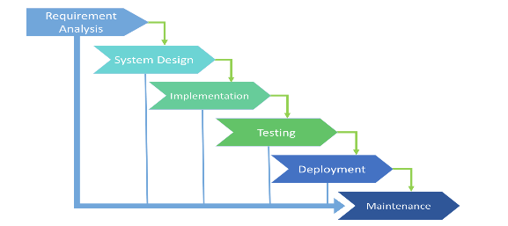
Methodology and Design
Will follow the normal flow of software development by implementing the Software Development Life Cycle (SDLC) model called (waterfall model),
Waterfall model :is Sequential meaning Each phase happens one after the other, like a waterfall flowing down.

Slide 13
Security ,privacy ,validation and verification
The system is a "stateless" or "client-side" application, as it does not store any user-specific information on the server-side. It relies on client-side processing,
Security and privacy
Validation and verification
the system does not collect important user data and does not implement databases, it reduces privacy concerns and security risks
User's device handles the computations and stores any necessary data locally. Greatly reducing unauthorized access to personal information.
Because this system aims to be a lightweight system and does not implement a data base ,it uses a system that generates meal codes ,these meal codes are then used to view previous meal plans

Slide 14
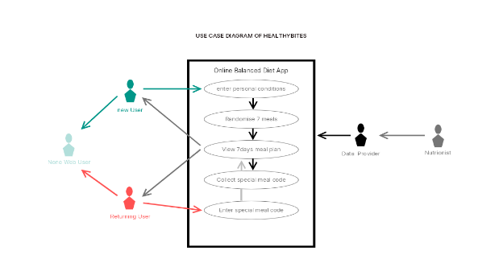
Use case Diagram
New User
Enter details
Randomize algorithm
Web Master
Nutritionist
Non web user
7 day meal plan
Special meal code
Returning user
Enter special code

Slide 15
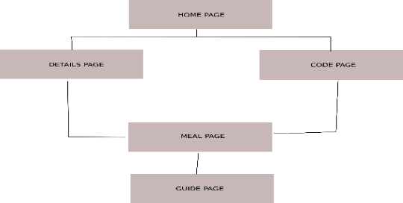
Site Map

Slide 16
Research Methodology
Research Approach : Qualitative research.
Sampling Strategy : Stratified sampling - dividing the population into subgroups (or strata) and selecting individuals from each subgroup in proportion to their representation in the population.
Research type : deductive research
Data collection techniques :observation,interview and questionnaires
Data analysis method : Qualitative data analysis involves examining non-numeric data such as text, images, or videos to identify themes, patterns, and meanings. Techniques include content analysis, thematic analysis, and grounded theory.
Ethical consideration : individuals who took part in the research had all their detail withheld

Slide 17
Research Methodology
The web application, "HealthyBites!," addresses the objective of developing a tool to generate a balanced diet for a week in order to tackle the issue of poor nutrition in Zambia, with a specific focus on high-risk groups.
Recommendation
Personalization: Tailor advice to user's health & goals.
Expert Collaboration: Partner with local nutrition pros.
Offline Access: No internet? App still works!
User Feedback: Get input for constant improvement.
Regular Updates: Stay current with latest nutrition info.

Slide 18
Thank You

